Slide 1
Craft Demo
Social Media Post Service

Slide 2
Objective
This social media post service exposes REST endpoints which can be used to execute the listed operations on a post -
Create
Read
Update
Delete

Slide 3
Technical Specifications
Programming Language: Java
Framework: Spring Boot
Database: H2
Testing Framework: JUnit, Mockito
Build Tool: Maven
IDE: IntelliJ IDEA

Slide 4
Functional Specifications
Get All Posts Endpoint
Get Post by Id
Create Post Endpoint
Update Post Endpoint
Delete Post Endpoint
Get Comments for a Post
Non-Functional Specifications
Must support frequent reads compared to other operations
Description field supports 1000 characters
Scalability
Must support listing of millions of posts

Slide 5
Assumptions
As part of editing a post, can add new comments
Posts are only in text format
Deleting comments not supported
Editing comments not supported
Posts might not be immediately consistent, but eventual consistency should be there in production

Slide 6
Service Layers and Architecture
H2 DB
LoadPostData
SocialMedia
PostsApp
ICommentService
Post Service
IPostRepository
PostDTO
CommentDTO
Comment Service
ICommentRepository
IPostService
PostController
PostRepositoryImpl
GlobalExceptionHandler
REST Client
SecurityConfig
CommentRepositoryImpl
ISpringDataPostRepo
PostEntity
ISpringDataCommentRepo
CommentEntity

Slide 7
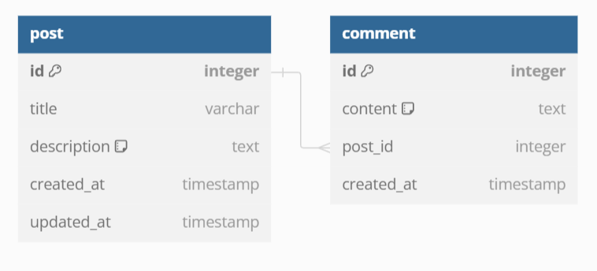
Database Schema

Slide 8
Design Decisions
Production
Relational Database (SQL):
Databases offer ACID compliance and are well-suited for structured data. Data might grow and have complex relationships and transactions with joins.
MySQL/PostgreSQL is suitable.
Caching
For caching and high-speed data access, consider using an in-memory data grid like Redis or Memcached. These can be used alongside your primary database to cache frequently accessed data and improve performance for frequently accessed posts.
Read Replicas
Read replicas are copies of the primary (master) database that are synchronized asynchronously to ensure eventual consistency. The primary database handles write operations (such as creating, updating, and deleting posts), while read replicas handle read operations (such as retrieving posts). They also provide HA.
Dev/Local
In memory DB recommended for dev environment and local testing

